Slide 1
Introduction to Logic
Fall 2024
CS-1005 Discrete Structures

Slide 2
1.3 Propositional Equivalence
Equivalent of Conditional
An important type of step used in a mathematical argument is the replacement of a statement with another statement with the same truth value.
This replacement is used extensively in the construction of mathematical arguments.
This replacement is used extensively in the construction of mathematical arguments.
We begin our discussion with a classification of compound propositions according to their possible truth values.

Slide 3
1.3 Propositional Equivalence
Compound Proposition
Classification of compound propositions
1. Tautology
A compound proposition that is always true, no matter what the truth values of the propositional variables that occur in it, is called a tautology.
Example
P | ¬ P | P ∨ ¬ P
T | F | T
F | T | T
1. P ∨ ¬ P is a tautology as:
2. P ∧ Q → P ∨ Q is a tautology as:
P | Q | P ∧ Q | P ∨ Q | P ∧ Q → P ∨ Q
T | T | T | T | T
T | F | F | T | T
F | T | F | T | T
F | F | F | F | T

Slide 4
1.3 Propositional Equivalence
Compound Proposition
Classification of compound propositions
2. Contradiction
A compound proposition that is always false, no matter what the truth values of the propositional variables that occur in it, is called a contradiction.
Example
P | ¬ P | P ∧ ¬ P
T | F | F
F | T | F
1. P ∧ ¬ P is a contradiction:
2. (P ⊕ Q) ∨ (P ↔ Q) is a contradiction:
P | Q | P ⊕ Q | P ↔ Q | (P ⊕ Q) ∨ (P ↔ Q)
T | T | F | T | F
T | F | T | F | F
F | T | T | F | F
F | F | F | T | F

Slide 5
1.3 Propositional Equivalence
Compound Proposition
Classification of compound propositions
3. Contingency
A compound proposition that is neither a tautology nor a contradiction is called a contingency.
P | Q | P∧Q
T | T | T
T | F | F
F | T | F
F | F | F
Example
1. P ∧ Q is a contingency:
2. P ∨ Q → P ∧ Q is a contingency as:
P | Q | P ∨ Q | P ∧ Q | P ∨ Q → P ∧ Q
T | T | T | T | T
T | F | T | F | F
F | T | T | F | F
F | F | F | F | T

Slide 6
1.3 Propositional Equivalence
Compound Proposition
Logical Equivalences
Compound propositions that have the same truth values in all possible cases are called logically equivalent.
We can also define this notion as follows.
The compound propositions p and q are called logically equivalent if p ↔ q is a tautology. The notation p ≡ q denotes that p and q are logically equivalent.
The symbol ≡ is not a logical connective, and
p ≡ q is not a compound proposition but rather
is the statement that p ↔ q is a tautology.
The symbol ⇔ is sometimes used instead of ≡ to denote logical equivalence.

Slide 7
1.3 Propositional Equivalence
Compound Proposition
Logical Equivalences
One way to determine whether two compound propositions are equivalent is to use a truth table.
In particular, the compound propositions p and q are equivalent if and only if the columns giving their truth values agree.
Example: Show that ¬(P ∨ Q) and ¬P ∧ ¬Q are logically equivalent : De Morgan Law
P Q | P ∨ Q | ¬(P ∨ Q) | ¬ P | ¬ Q | ¬P ∧ ¬Q
T T | T | F | F | F | F
T F | T | F | F | T | F
F T | T | F | T | F | F
F F | F | T | T | T | T
¬(P ∨ Q)↔¬P ∧ ¬Q
T
T
T
T
¬(P ∨ Q) ↔ ¬P ∧ ¬Q is a tautology

Slide 8
1.3 Propositional Equivalence
Compound Proposition
Logical Equivalences
Example: Show that P → Q and ¬P ∨ Q are logically equivalent
P | Q | P→Q | ¬ P | ¬P ∨ Q
T | T | T | F | T
T | F | F | F | F
F | T | T | T | T
F | F | T | T | T
P→ Q
P | Q | P→Q
1 | 1 | 1
1 | 0 | 0
0 | 1 | 1
0 | 0 | 1
Product of Maxterms
= ( P’ + Q )
= ¬P ∨ Q

Slide 9
1.3 Propositional Equivalence
Compound Proposition
Logical Equivalences
distributive law of disjunction over conjunction.
Example: Show that P ∨ (Q ∧ R) and (P ∨ Q) ∧ (P ∨ R) are logically equivalent
P Q R | Q ∧ R | P ∨ (Q∧ R) | P ∨ Q | P ∨ R | (P ∨ Q) ∧ (P ∨ R)
T T T | T | T | T | T | T
T T F | F | T | T | T | T
T F T | F | T | T | T | T
T F F | F | T | T | T | T
F T T | T | T | T | T | T
F T F | F | F | T | F | F
F F T | F | F | F | T | F
F F F | F | F | F | F | F

Slide 10
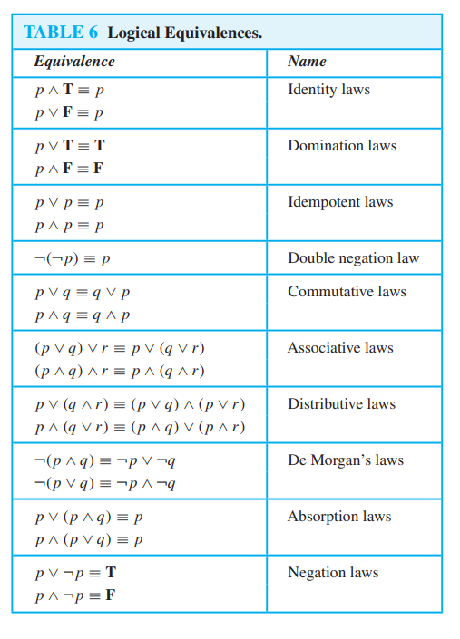
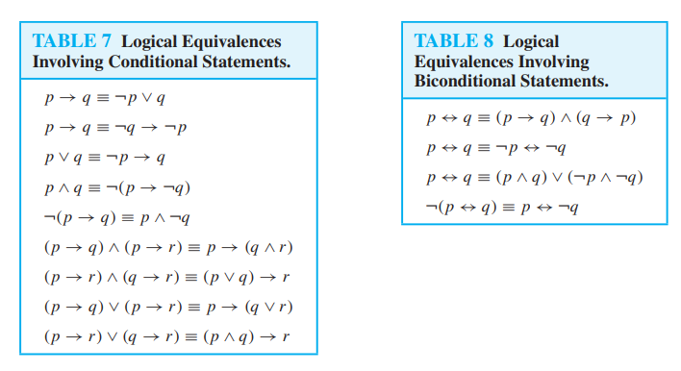
1.3 Propositional Equivalence
Compound Proposition
Logical Equivalences

Slide 11
1.3 Propositional Equivalence
Compound Proposition
Constructing New Logical Equivalences
The logical equivalences in Table 6, Table 7 and 8 can be used to construct additional logical equivalences.
The reason for this is that a proposition in a compound proposition can be replaced by a compound proposition that is logically equivalent to it without changing the truth value of the original compound proposition.

Slide 12
1.3 Propositional Equivalence
Compound Proposition
Constructing New Logical Equivalences
Example 1: Show that ¬(P → Q) and P ∧ ¬Q are logically equivalent
Use truth table
or
Use logical identities
: in case of large no. of variables
Solution :
¬(P → Q) =
¬(¬P ∨ Q)
: Using logical Identity
= ¬(¬P) ∧ ¬Q)
: De Morgan Law
= P ∧ ¬Q

Slide 13
1.3 Propositional Equivalence
Compound Proposition
Constructing New Logical Equivalences
Example 2: Show that ¬(P ∨ (¬P ∧ Q)) and ¬P ∧ ¬Q are logically equivalent
Solution :
Using logical identities
¬(P ∨ (¬P ∧ Q)) =
¬P ∧ ¬(¬P ∧ Q)
: De Morgan Law
= ¬P ∧ (¬(¬P ) ∨ ¬Q)
= ¬P ∧ (P ∨ ¬Q)
= (¬P ∧ P ) ∨ (¬P ∧ ¬Q)
: Distributive Law
= F ∨ (¬P ∧ ¬Q)
= (¬P ∧ ¬Q)

Slide 14
1.3 Propositional Equivalence
Compound Proposition
Constructing New Logical Equivalences
Example 3: Show that (P ∧ Q) → (P ∨ Q) is a tautology.
Solution :
Using logical identities
(P ∧ Q) → (P ∨ Q) =
¬ (P ∧ Q) ∨ (P ∨ Q)
: P → Q = ¬ P ∨ Q
= (¬P ∨ ¬ Q) ∨ (P ∨ Q)
= ( ¬P ∨ P) ∨ (¬Q ∨ Q)
= T ∨ T
= T

